Slide 1
UMM Unlearning Knows But Can't Draw: Toward Modality-Selective Concept Suppression in Unified Multimodal Models
May 13th, 2026
Hayeon Jeong
Notes:
영어
I haven’t had many opportunities to discuss research in English yet,
I hope you’ll understand if I sound a bit awkward or unintentionally impolite at times.
녹음
Also, do you mind if I record this meeting…? In case of misunderstanding the contents from this meeting,,,
could I record our meeting for next several times? Until I get used to discuss research in English?
이제까지 한거, 다른 것도 관심
So, I would like to share the research that I was doing for last two months…
But as I mentioned in the email, there is no complete method and results yet,,,
So, I also would like to say, I am open to other topics about interpretability or safety, and so on ,,,, on generative models or multimodal models.
시작
Shall I begin?

Slide 2
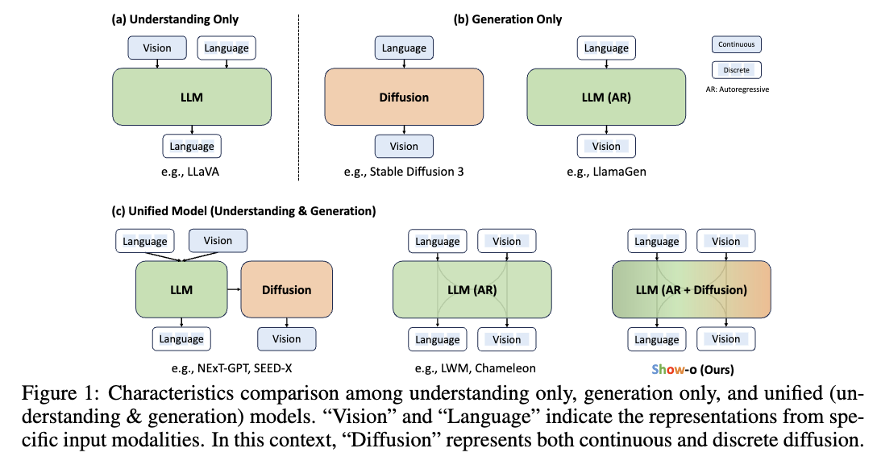




Base Model Architecture
UMM (Unified Multimodal Models)
One model handles text & image(vae) tokens.
Text tokens support understanding.
VAE tokens drive image generation.
The tokens meet in a shared transformer.
We hook the VAE-side hidden state.
Sequence
[Text Tokens] + [VAE (image) Tokens]
X NN
[Text Tokens]
[VAE (image) Tokens]
(Understanding)
$$W^{Q_und}, W^{K_und}, W^{V_und}$$
(Generation)
$$W^{Q_gen}, W^{K_gen}, W^{V_gen}$$
Text Q, K, V
VAE Q, K, V
Self-Attention
(Understanding)
$${FFN}^{und}$$
(Generation)
$${FFN}^{gen}$$
Generated
Text
Generated
Image
(any text tasks)
(generation, editing)
Notes:
타겟 모델 -> 익숙?
- The model I’m focusing on is UMM.
I was wondering if you’re familiar with this model.
설명 + Task 예시
3문장 읽기
To put it simply, for example,
If we only put text paragraph or prompts, the model act exactly same as Large Language Model. So, it can do any kind of text tasks.
Also, if we put image (or image and description or direction,), the model act as T2I (Text to Image) model. Then, it generates or edits the images that we put.
최근 구조: AR + Diffusion
- The text modality works autoregressively, while the image modality uses a diffusion-based process.

Slide 3
Base Model Architecture
Applicability Assessment Criteria
Whether generation-side tokens or latents can be separated
Whether they meet the text stream in a shared context
Whether hook-based intervention can be restricted to the generation side
Models by Release Order and Applicability Assessment
Model | Applicability | Github Released | Title | Citations | Release Date
Transfusion | △ | O | Transfusion: Predict the Next Token and Diffuse Images with One Multi-Modal Model | 496 | 2024-08-20
Show-o | △ | O | Show-o: One Single Transformer to Unify Multimodal Understanding and Generation | 631 | 2024-08-22
MonoFormer | △ | O | MonoFormer: One Transformer for Both Diffusion and Autoregression | 50 | 2024-09-24
JanusFlow | △ |  | JanusFlow: Harmonizing Autoregression and Rectified Flow for Unified Multimodal Understanding and Generation | 198 | 2024-11-12
LMFusion | △ |  | LMFusion: Adapting Pretrained Language Models for Multimodal Generation | 27 | 2024-12-19
Nexus-Gen | X |  | Nexus-Gen: Unified Image Understanding, Generation, and Editing via Prefilled Autoregression in Shared Embedding Space | 4 | 2025-04-30
Mogao | O |  | Mogao: An Omni Foundation Model for Interleaved Multi-Modal Generation | 71 | 2025-05-08
BAGEL | O | O | Emerging Properties in Unified Multimodal Pretraining | 486 | 2025-05-20

Slide 4
Base Model Architecture
Models by Release Order and Applicability Assessment
Model | Applicability | Github Released | 논문 | Citations | Release Date
OpenUni | X |  | OpenUni: A Simple Baseline for Unified Multimodal Understanding and Generation | 22 | 2025-05-29
Show-o2 | △ |  | Show-o2: Improved Native Unified Multimodal Models | 132 | 2025-06-18
LightFusion | O |  | LightFusion: A Light-weighted, Double Fusion Framework for Unified Multimodal Understanding and Generation | 8 | 2025-10-27
HBridge | X |  | HBridge: H-Shape Bridging of Heterogeneous Experts for Unified Multimodal Understanding and Generation | 2 | 2025-11-25
TUNA | △ |  | TUNA: Taming Unified Visual Representations for Native Unified Multimodal Models | 13 | 2025-12-01
EMMA | X | O | EMMA: Efficient Multimodal Understanding, Generation, and Editing with a Unified Architecture | 4 | 2025-12-04
InternVL-U | X |  | InternVL-U: Democratizing Unified Multimodal Models for Understanding, Reasoning, Generation and Editing | 2 | 2026-03-10

Slide 5
Problem Statement
Sequence
[Text Tokens] + [VAE (image) Tokens]
X NN
[Text Tokens]
[VAE (image) Tokens]
(Understanding)
$$W^{Q_und}, W^{K_und}, W^{V_und}$$
(Generation)
$$W^{Q_gen}, W^{K_gen}, W^{V_gen}$$
Text Q, K, V
VAE Q, K, V
Self-Attention
(Understanding)
$${FFN}^{und}$$
(Generation)
$${FFN}^{gen}$$
Generated
Text
Generated
Image
Notes:
이 모델을 공부하면서, 멀티모달 생성 테스크에서 발생할 수 있는
흔한 문제들을 생각하기 시작했습니다.
While studying the model, I started to think about some common problem scenarios that could happen in multimodal generation tasks.

Slide 6
Problem Statement
Scenarios
Celebrity or private faces
Copyrighted characters
Artist-specific styles
IDs and private documents
Graphic violence or sexual concept
Sequence
[Text Tokens] + [VAE (image) Tokens]
X NN
[Text Tokens]
[VAE (image) Tokens]
(Understanding)
$$W^{Q_und}, W^{K_und}, W^{V_und}$$
(Generation)
$$W^{Q_gen}, W^{K_gen}, W^{V_gen}$$
Text Q, K, V
VAE Q, K, V
Self-Attention
(Understanding)
$${FFN}^{und}$$
(Generation)
$${FFN}^{gen}$$
Generated
Text
Generated
Image
Notes:
Text side에서는 모델이 concept을 이해하고 설명할 수 있어야 합니다.
예를 들어 모델은 public figure가 누구인지 설명할 수 있어야 합니다. 저작권 캐릭터가 무엇인지, 특정 작가의 화풍이 어떤지, 가짜 신분증이 왜 위험한지도 설명할 수 있어야 합니다.
하지만 같은 concept가 image generation에서는 위험할 수 있습니다. 모델이 개인 얼굴을 realistic하게 새로 생성하면 안 되는 경우가 있습니다. 보호된 캐릭터와 거의 같은 이미지를 생성하면 안 될 수도 있습니다. 특정 작가의 스타일을 그대로 따라 새 그림을 만드는 것도 제한해야 할 수 있습니다. 또 실제처럼 보이는 신분증, 노골적인 폭력 이미지, 성적 이미지는 생성 억제가 필요합니다.

Slide 7
Problem Statement
Scenarios
Celebrity or private faces
Copyrighted characters
Artist-specific styles
IDs and private documents
Graphic violence or sexual concept
Goal
Not to erase concepts in whole model completely,
Only unsafe generation side
Sequence
[Text Tokens] + [VAE (image) Tokens]
X NN
[Text Tokens]
[VAE (image) Tokens]
(Understanding)
$$W^{Q_und}, W^{K_und}, W^{V_und}$$
(Generation)
$$W^{Q_gen}, W^{K_gen}, W^{V_gen}$$
Text Q, K, V
VAE Q, K, V
Self-Attention
→ Knows but can’t draw…
(Understanding)
$${FFN}^{und}$$
(Generation)
$${FFN}^{gen}$$
Generated
Text
Generated
Image
Notes:
그래서 목표는 selective합니다. Concept에 대한 모든 지식을 없애려는 것이 아닙니다. Safe understanding은 유지하고, unsafe rendering만 억제하려는 것입니다. 이것이 "knows but can't draw" 문제 설정입니다.
If anything is unclear so far, please let me know.

Slide 8
Method: Contrastive Feature Selection
UnlearnCanvas
20 object classes
× 80 anchor prompts per class
× (51 style postfix + 1 base prompt)
= 83,200
Unsupervised SAE Training
Train a TopK SAE on the VAE-side hidden states of UMM(Bagel)
A dog wearing aviator goggles piloting an airplane
A dachshund stretched out like a limousine
A poodle with an elaborate hairstyle as a florist
A dog astronaut floating in space with a bone-shaped spaceship
A beagle detective with a magnifying glass
Notes:
This is the method I was trying,,,
There are 8 steps.
첫번째로, unlearncanvas라는 unlearning task에 자주 쓰이는 프롬프트 셋을 준비합니다.
총 20개 클래스 별 80개의 다양한 프롬프트가 있고,
여기 있는 모든 개념을 동시에 모두 suppress하는게 목표입니다.
그래서 이 모든 프롬프트를 SAE에 학습시킵니다.

Slide 9
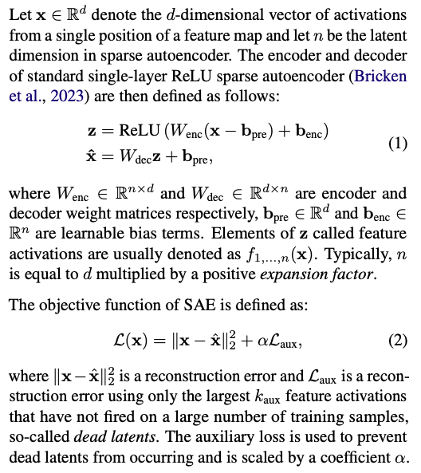






(Method)
A dog wearing aviator goggles piloting an airplane
A dachshund stretched out like a limousine
A poodle with an elaborate hairstyle as a florist
A dog astronaut floating in space with a bone-shaped spaceship
A beagle detective with a magnifying glass
Training
prompts
Sequence
[Text Tokens] + [VAE (image) Tokens]
Unsupervised Learning on SAE
SAE Forward:
$v=W_{enc}\left(x −b_{pre}\right)+b_{enc}$
$z=TopK\left(ReLU\left(v\right), k=32\right)$
$\hat{x}=W_{dec}z+b_pre$
Loss: ${\left\|x − \hat{x}\right\|}_{2}^{2}+αℒ_{aux}$
X NN
[Text Tokens]
[VAE (image) Tokens]
(Understanding)
$$W^{Q_und}, W^{K_und}, W^{V_und}$$
(Generation)
$$W^{Q_gen}, W^{K_gen}, W^{V_gen}$$
Text Q, K, V
VAE Q, K, V
Self-Attention
(Understanding)
$${FFN}^{und}$$
(Generation)
$${FFN}^{gen}$$
1024(64*64) vae tokens
Input
activation
$$x$$
i1 | i2 | i3 | …
3584
$$W_{enc}$$
*32
$$z$$
i1 | i2 | i3 | …
3584
*32
=57,344
Latent
representation
→ Overall, the goal is to decompose the model’s internal activations into a small number of sparse features, so that each latent can learn more meaningful and disentangled features.
$$W_{dec}$$
/32
output
activation
$$\hat{x}$$
i1 | i2 | i3 | …
3584
Notes:
이 부분은 Sparse Autoencoder(SAE)의 기본 구조와 학습 objective를 정리한 것입니다.
(앞에서 언급하는걸 까먹었는데, 베이글 모델에서 28개 블록 중에 딱 하나의 레이어 24를 지정해서, 그 바로 뒤에 SAE를 붙인다.
먼저 입력 activation x를 encoder에 통과시켜 latent representation z를 만듭니다. 이때 ReLU를 적용하고, Top-K를 사용해서 가장 큰 activation 32개만 남기도록 해서 sparse representation을 강제합니다.
그 다음 decoder가 sparse latent z를 이용해서 원래 activation \hat{x}를 복원합니다.
Loss는 reconstruction loss와 auxiliary loss로 구성됩니다. Reconstruction loss는 입력과 복원 결과의 차이를 최소화하는 역할이고, auxiliary loss는 일부 latent가 전혀 활성화되지 않는 dead latent 문제를 완화하기 위해 추가됩니다.
즉 전체적으로는, 모델 내부 activation을 sparse한 feature들의 조합으로 분해하고, 각 latent가 더 disentangled된 의미 있는 feature를 학습하도록 만드는 구조라고 볼 수 있습니다.”
This part explains the basic structure and training objective of the Sparse Autoencoder, or SAE.
I forgot to mention this earlier, but in the Bagel model, there are 28 blocks, and I attach the SAE to only one specific layer, which is layer 24.
First, the input activation x passes through the encoder and becomes a latent representation z.
After applying ReLU, Top-K is used / so that only the 32 largest activations remain.
This forces the representation to be sparse.
Then, the decoder TAKES z AND reconstruct the original activation \hat{x}.
The loss consists of two parts: the reconstruction loss and the auxiliary loss.
The reconstruction loss minimizes the difference between the original activation and the reconstructed activation.
The auxiliary loss reduces the dead latent problem, where some latent are never activated during training.
Overall, the goal is to decompose the model’s internal activations into a small number of sparse features, so that each latent can learn more meaningful and disentangled features.

Slide 10
Method: Contrastive Feature Selection
Construction of a Matched Prompt Set
To identify which combinations of SAE features are meaningful for each concepts.
For the same scene, construct target, background, and retain prompts.
Target: A horse in a forest.
Background: An empty forest.
Retain: A cow in a forest.
Retain: A deer in a forest.
Notes:
그렇게 unsupervised learned SAE를 가지고 각 개념마다 어떤 SAE feature의 조합이 의미있는지 판단하기 위해 추가 작업을 한다.
만약 horse라는 개념을 지우고 싶으면,
- 이렇게 아무것도 없는 프롬프트,
cow, deer처럼 비슷한 개념
프롬프트를 준비한다.
After that, there is another step to identify which combinations

Slide 11
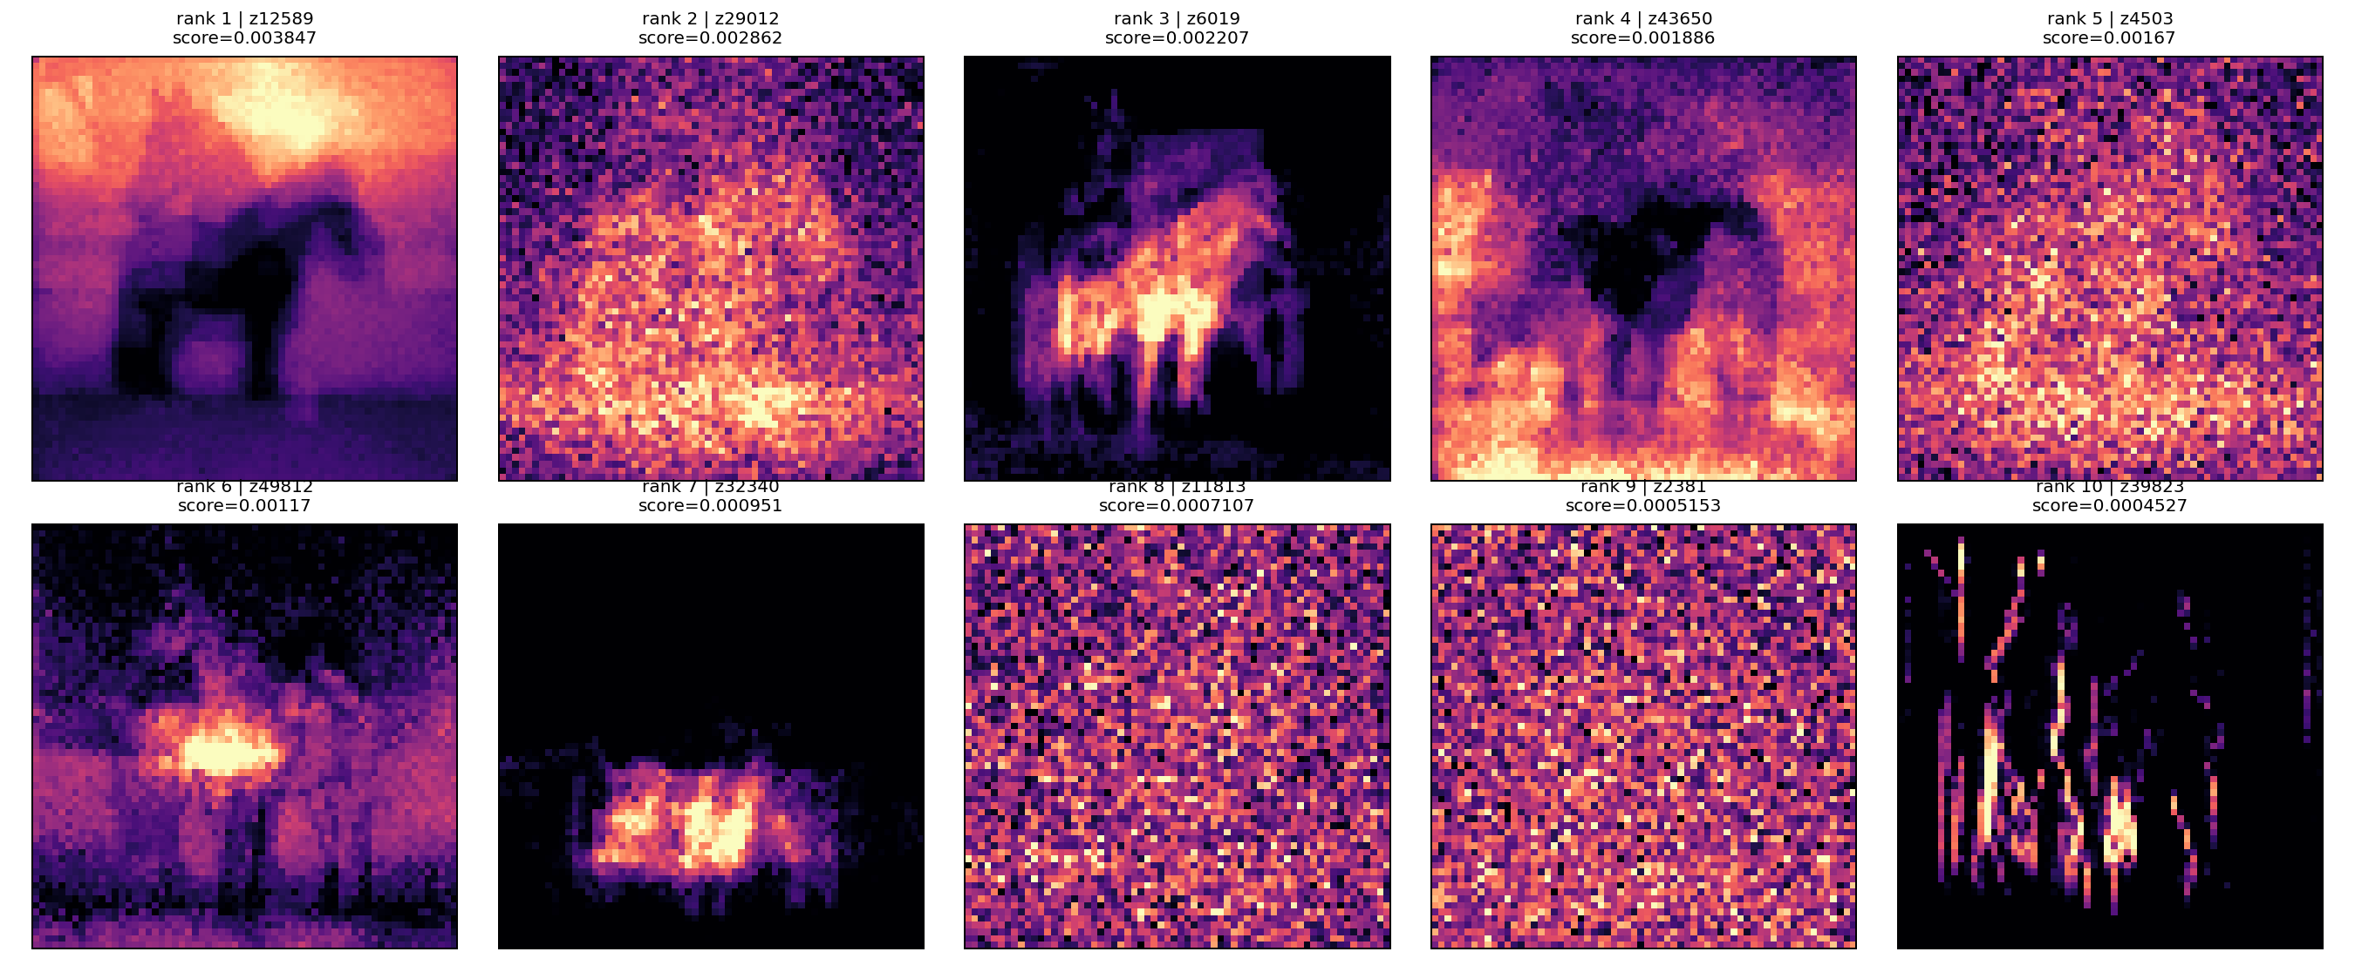
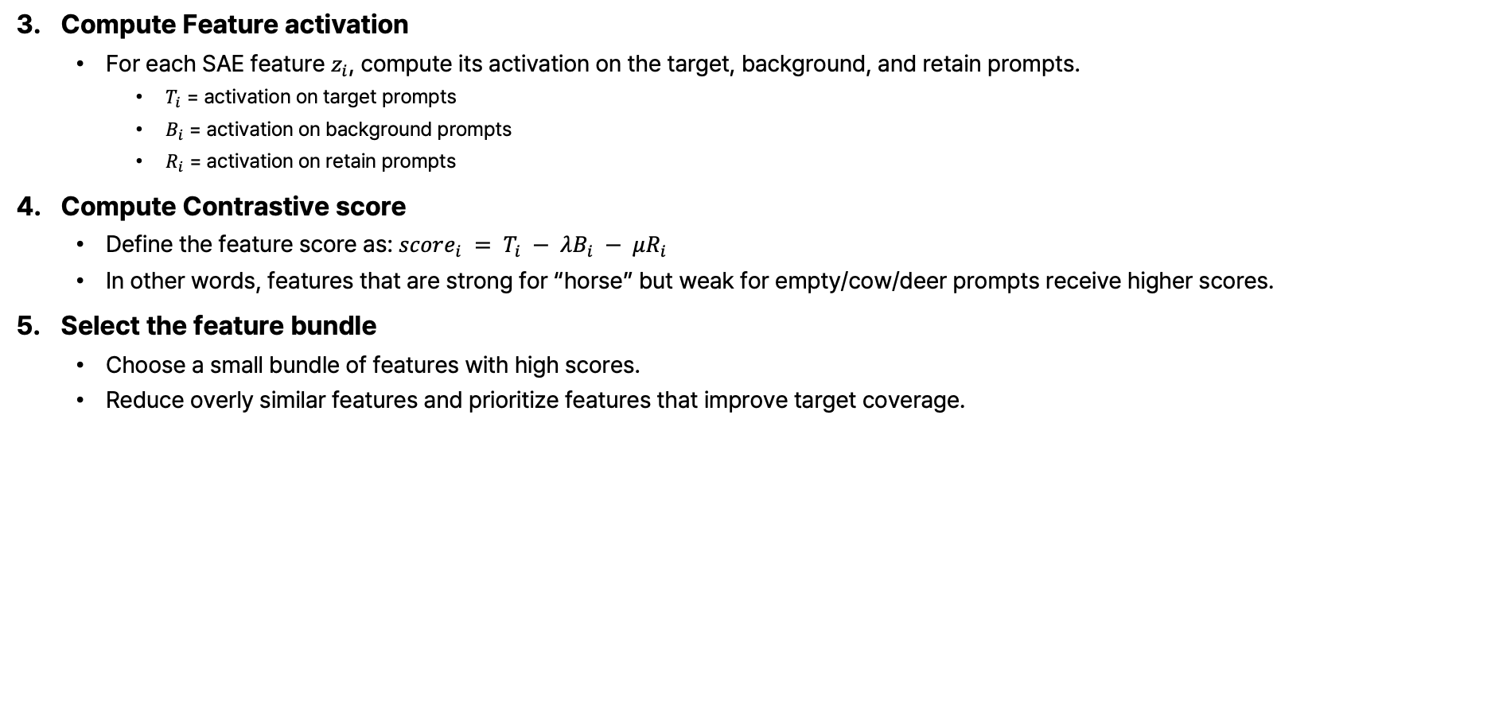
Method: Contrastive Feature Selection
Compute Feature activation
For each SAE feature $z_{i}$, compute its activation on the target, background, and retain prompts.
$T_{i}$ = activation on target prompts
$B_{i}$ = activation on background prompts
$R_{i}$ = activation on retain prompts
Compute Contrastive score
Define the feature score as: $score_{i} = T_{i} − λB_{i} − μR_{i}$
In other words, features that are strong for “horse” but weak for empty/cow/deer prompts receive higher scores.
Select the feature bundle
Choose a small bundle of features with high scores.
Reduce overly similar features and prioritize features that improve target coverage.
* preservation
Notes:
그리고 각 feature에 대한 준비한 프롬프트 별 activation을 계산한다.
그리고 지우려는 target에서는 잘 활성화되고, 다른 개념들에서는 활성화되지 않는 feature를 고른다.

Slide 12
Notes:
이건 여러 이미지에서 horse 이미지가 feature 별로 (on average, 평균적으로) 어떤 곳에 더 집중하는지 heatmap을 그려본 것이다.
근데 사실 이건 아직 앞의 식에서 B_i, R_i가 포함되지 않은 형태라서,
Counterfactual prompt들을 이용해서 필터링하면 명확하게 몇개의 feature가 객체 위치에만 추출 되는지는 확인을 해 봐야한다.
배경 부분이 너무 달라서 object 부분 보다 배경의 차이로 인해 score가 높을 수도 있는 단점이 있다.

Slide 13
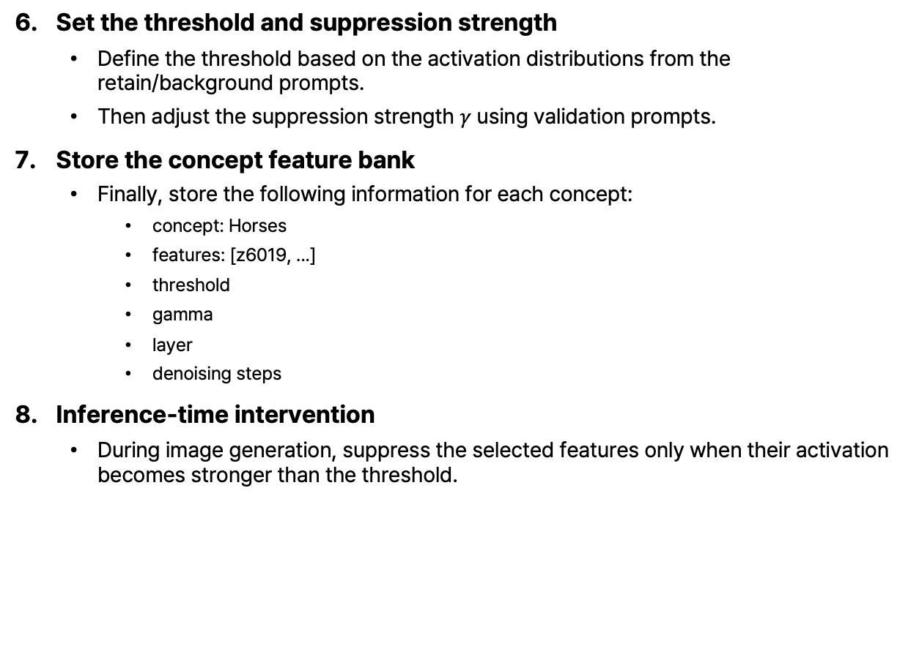


Method: Contrastive Feature Selection
A dog wearing aviator goggles piloting an airplane
A dachshund stretched out like a limousine
A poodle with an elaborate hairstyle as a florist
A dog astronaut floating in space with a bone-shaped spaceship
A beagle detective with a magnifying glass
Test
prompts
Sequence
[Text Tokens] + [VAE (image) Tokens]
Set the threshold and suppression strength
Define the threshold based on the activation distributions from the retain/background prompts.
Then adjust the suppression strength $γ$ using validation prompts.
Store the concept feature bank
Finally, store the following information for each concept:
concept: Horses
features: [z6019, ...]
threshold
gamma
layer
denoising steps
Inference-time intervention
During image generation, suppress the selected features only when their activation becomes stronger than the threshold.
X NN
[Text Tokens]
[VAE (image) Tokens]
(Understanding)
$$W^{Q_und}, W^{K_und}, W^{V_und}$$
(Generation)
$$W^{Q_gen}, W^{K_gen}, W^{V_gen}$$
Text Q, K, V
VAE Q, K, V
Self-Attention
(Understanding)
$${FFN}^{und}$$
(Generation)
$${FFN}^{gen}$$
$$x$$
i1 | i2 | i3 | …
3584
$$W_{enc}$$
*32
i1 | i2 | i3 | …
3584
*32
=57,344
$$z$$
Feature z6019 * 0
$$W_{dec}$$
/32
$$\hat{x}$$
i1 | i2 | i3 | …
3584
Notes:
그렇게 높은 score를 가진 feature들의 meta data를 저장해둔 후, inference 시에 그 feature에만 *0을 곱해서 suppress한다.
이상적으로는 그렇게 하면 말의 개념이 사라지고 배경이나 cow, deer의 형태가 나오는 것이다.
---------------------------------------------------
I wanted to apply interventions, then see the generated results.
If the horse concept were removed, it would suggest that the approach has potential.
However, the Yonsei server uses a queue-based GPU allocation system.
Recently, the queue has been very crowded, and even after waiting for two days, I could not get access to a GPU.
As a result, I was not able to generate and evaluate the image outputs yet.

Slide 14
Methods (In Short)
Collect prompts for the target concept.
Run BAGEL and cache VAE-side hidden states.
Train an unsupervised TopK SAE on the cached states.
Rank SAE features by target-concept activation.
Use counterfactual prompts to filter concept-specific features.
Select candidate features, such as z6019 for Horses.
Suppress selected features during image generation.
Evaluate target suppression and image preservation.
Notes:
짧게 정리하면,
지우고 싶은 개념 프롬프트들로 unsupervised SAE를 학습시키고,
거기서 topK feature를 필터링한 다음,
Counterfactural prompt를 이용해서 그 개념이 특히 어떤 feature에서 unique한 특징을 보이는지 찾는다.
그리고 그 feautre를 intervention에서 suprress하면 개념이 나오지 않는다.

Slide 15




Contributions (Goals)
The first work unlearning/suppression work on UMM
The first work of modality selective unlearning/suppression
We use SAE-based methods to perform unlearning/suppression while preserving image generation quality. Although the core technique itself is based on existing methods*, we apply it in the context of UMM unlearning.
In addition, we introduce counterfactual prompts to better separate the target concept from related concepts during the unlearning process. (no need to train more for preservation)
$$x$$
i1 | i2 | i3 | …
3584
$$W_{enc}$$
*32
i1 | i2 | i3 | …
3584
*32
=57,344
$$z$$
$$W_{dec}$$
/32
$$\hat{x}$$
i1 | i2 | i3 | …
3584
* SAeUron: Interpretable Concept Unlearning in Diffusion Models with Sparse Autoencoders (ICML 2025)
** ItD Sparse Autoencoder as a Zero-Shot Classifier for Concept Erasing in Text-to-Image Diffusion Models
*** SAEmnesia Erasing Concepts in Diffusion Models with Supervised Sparse Autoencoders
Notes:
So, the contributions that I ideally envision are the following:
To the best of my knowledge, this would be the first work on unlearning for UMMs.
It would also be the first work on modality-selective unlearning.
We use SAE-based methods to perform unlearning while preserving image generation quality. Although the core technique itself is based on existing methods, we apply it in the context of UMM unlearning.
In addition, we introduce counterfactual prompts to better separate the target concept from related concepts during the unlearning process.
The last part will depend on the method, but for now I set it up like this.

Slide 16
Remaining Research Questions / Discussions so far
Remaining Research Questions
Beyond simple text prompts (+ think/reasoning mode)
May better detect concepts internally remembered by the model
The model may still generate unintended features on its own
Object/background separation is often unclear during inference
Non-general cases (e.g., objects at image corners) remain challenging
Closer to blocking/filtering than true complete unlearning
Discussion
Which Layer to attach SAE? (can be decided by ablation, but why? Should be explained technically)
How big is SAE is?
SAE:
input_dim = 3,584
latent_dim = 57,344
params = 411,102,720 ≈ 0.41B
BAGEL ema.safetensors:
params = 14,607,260,128 ≈ 14.6B
ratio:
0.411B / 14.607B ≈ 2.8%
How long it takes to train?
2.5h on pro6000 (Only objects)
Notes:
- These are the remaining research questions and discussions so far.
One possible future direction is
to go beyond simple text prompts
and also use the think/reasoning mode of UMM models.
By analyzing the images generated from the model’s own reasoning process, we may better detect the concepts that the model still internally remembers.
However, the model may also generate additional unintended features by itself.
Also, the separation between object and background is often unclear during inference, especially in non-general cases such as when the object appears at the corner of the image.
Additionally, the current approach is closer to blocking or filtering than to complete unlearning.
This is why I am still thinking carefully about whether I should continue this direction further.

Slide 17
Research Interest
Generative Models
Computer Vision
Multimodal Models
Interpretability
Notes:
That’s everything I wanted to share.
That’s all I prepared

